Slide 1
Hammöck
Group 7: Omar Cisse, Adam Colwell, Brandyn Holmes, Michael Lobo, Garyn Pieterse, Eric Smith, Hunter Walker

Slide 2
User Prototype Task
Task 1: Click on the application in the top right corner
Task 2: Click Continue
Task 3: Click on Group 7 Gang
Task 4: Click on the plus sign to add an application to your family chat
Task 5: Out of the three applications select the one(s) you would like by clicking the button on the right
Task 6: Click the bar at the top to finish adding selected application(s)

Slide 3

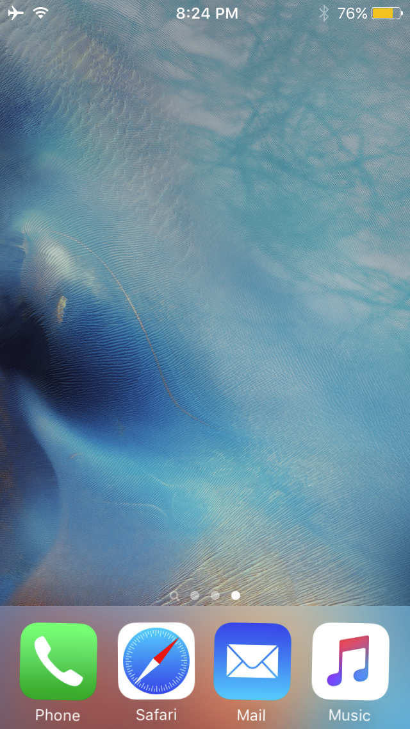
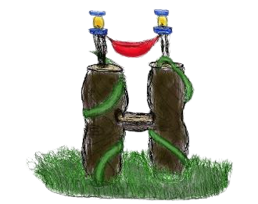
Hammock

Slide 4

Sign Up
Email
group7@cap3104.com
On opening the app for the first time, the user is prompted to either create an account or sign-in
Password
************
I agree to the Terms of Services and Privacy Policy.
Continue
Hammöck
Have an Account?
Sign In

Slide 5
Sign Up
A similar color theme is used throughout the app for consistency
Email
group7@cap3104.com
Password
************
I agree to the Terms of Services and Privacy Policy.
Continue
Hammöck
Have an Account?
Sign In

Slide 6
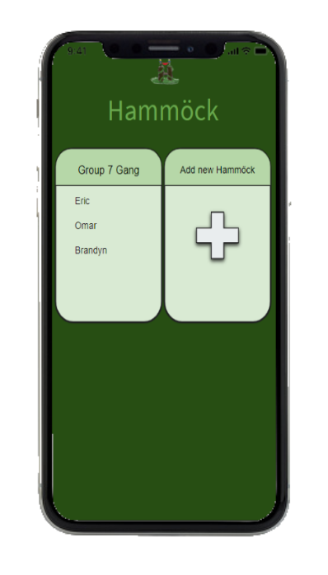
Hammöck
Group 7 Gang
Add new Hammöck
Eric
Omar
Brandyn
A new chat can be created with a single tap of the plus button
Conversations are organized in one, easy-to-access location. Users can also see an overview of who is in each conversation.

Slide 7
Hammöck
Customized names can be given to each conversation, so that the user can keep track of multiple chats
Group 7 Gang
Add new Hammöck
Eric
Omar
Brandyn

Slide 8
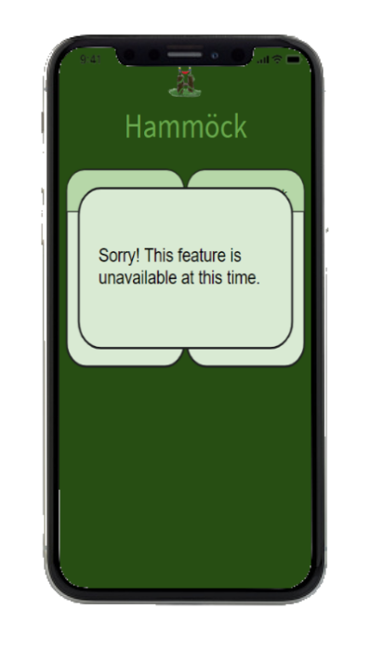
Hammöck
Group 7 Gang
Add new Hammöck
Eric
Omar
Brandyn
Sorry! This feature is unavailable at this time.

Slide 9
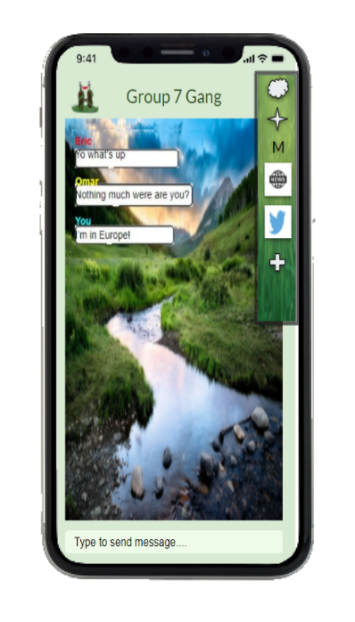


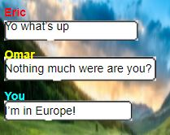


The toolbar allows for seamless integration with other apps. Users can easily recognize the icons of different apps that they are able to import content from
Group 7 Gang
Eric
Yo what’s up
Omar
Nothing much were are you?
You
I’m in Europe!
M
Tapping the plus button allows you to add another app to the toolbar
Type to send message....

Slide 10
The name of the group is visible at the top of the screen, so that the user is aware of which conversation is open
Group 7 Gang
Eric
Yo what’s up
Omar
Nothing much were are you?
You
I’m in Europe!
M
The labeled text box indicates where the user can type to send messages
Type to send message....

Slide 11
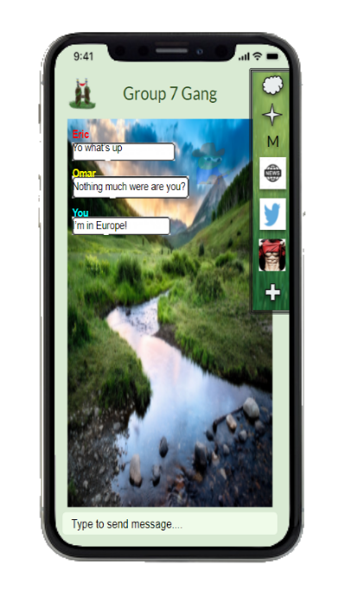



Group 7 Gang
Eric
Yo what’s up
Omar
Nothing much were are you?
You
I’m in Europe!
M
Type to send message....

Slide 12
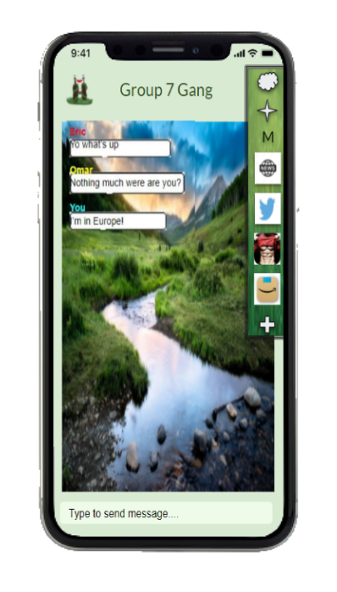

Group 7 Gang
Eric
Yo what’s up
Omar
Nothing much were are you?
You
I’m in Europe!
M
Type to send message....

Slide 13
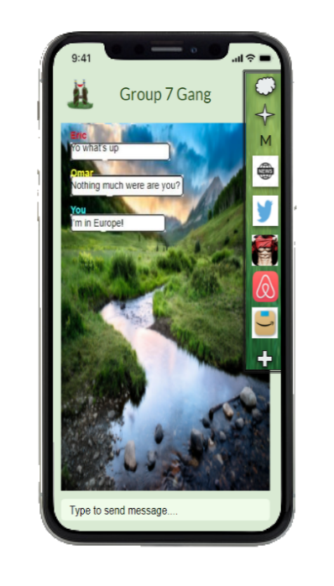

Group 7 Gang
Eric
Yo what’s up
Omar
Nothing much were are you?
You
I’m in Europe!
M
Type to send message....

Slide 14
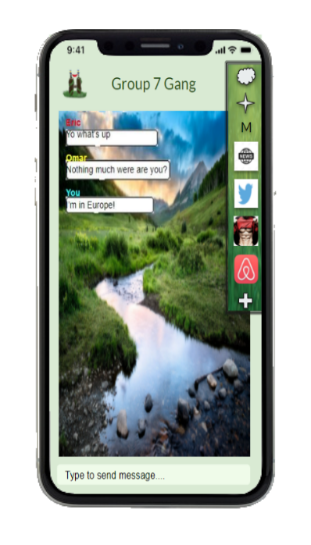
Group 7 Gang
Eric
Yo what’s up
Omar
Nothing much were are you?
You
I’m in Europe!
M
Type to send message....

Slide 15
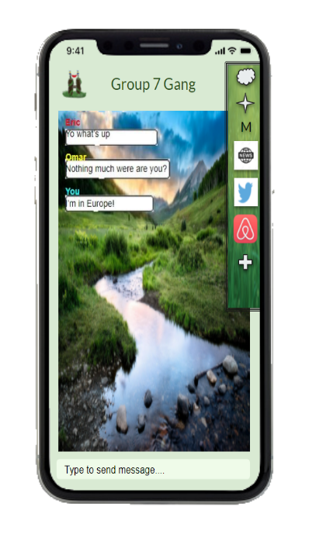
Group 7 Gang
Eric
Yo what’s up
Omar
Nothing much were are you?
You
I’m in Europe!
M
Type to send message....

Slide 16
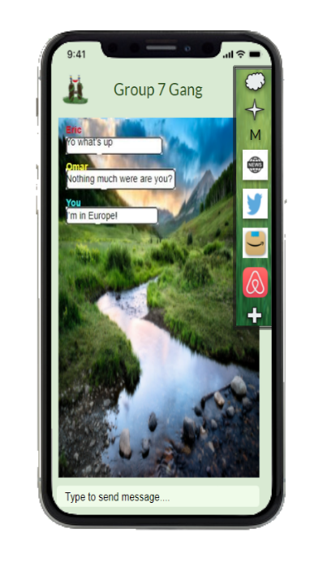
Group 7 Gang
Eric
Yo what’s up
Omar
Nothing much were are you?
You
I’m in Europe!
M
Type to send message....

Slide 17
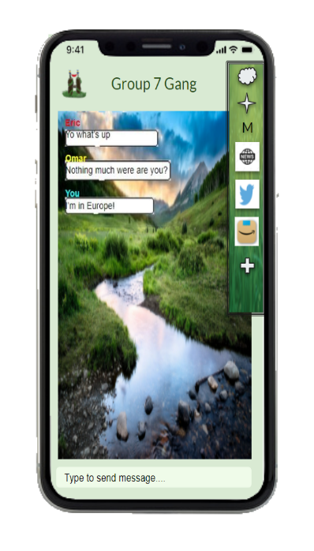
Group 7 Gang
Eric
Yo what’s up
Omar
Nothing much were are you?
You
I’m in Europe!
M
Type to send message....

Slide 18
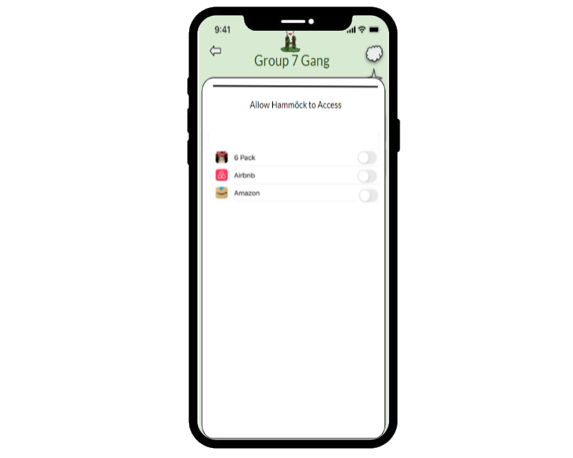
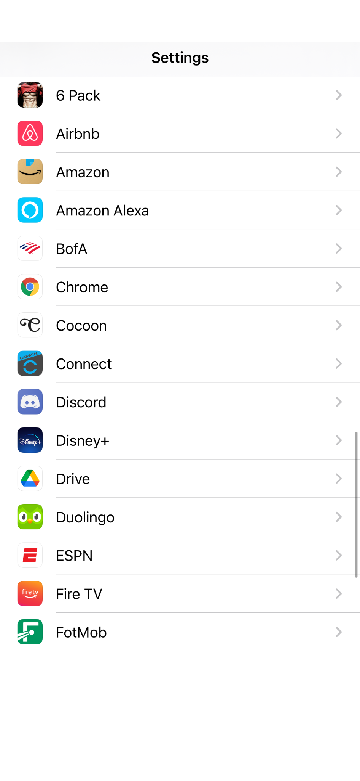

Group 7 Gang
Eric
Yo what’s up
Next User
Comment
Another User
Comment
M
Allow Hammöck to Access
Users can toggle on and off permissions for each app. This makes it simple for the user to understand which apps are able to access their data
Type to send message....

Slide 19
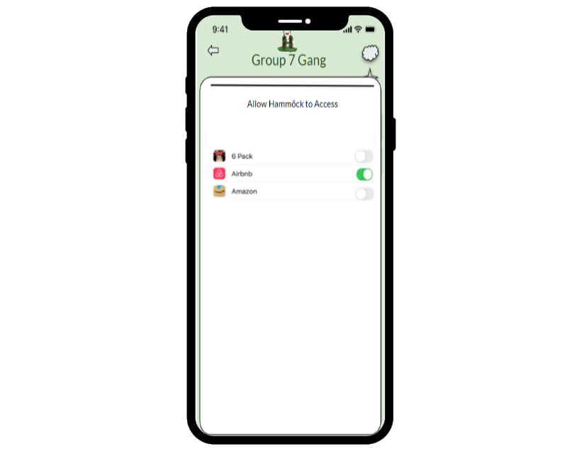

Group 7 Gang
Eric
Yo what’s up
Next User
Comment
Another User
Comment
M
Allow Hammöck to Access
Type to send message....

Slide 20
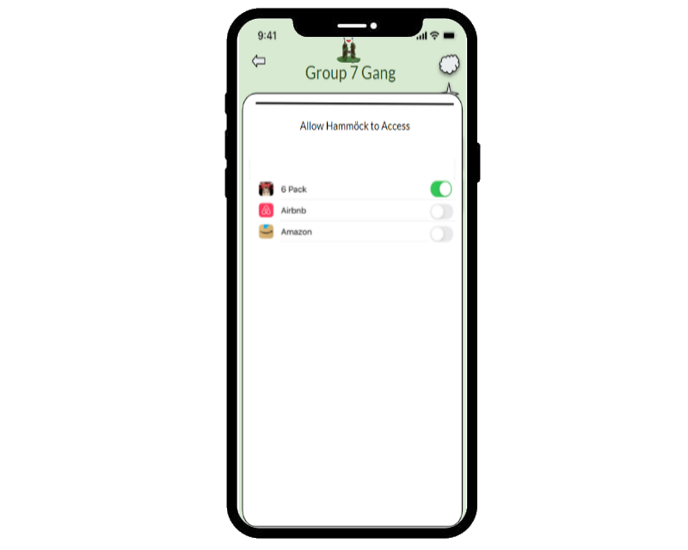
Group 7 Gang
Eric
Yo what’s up
Next User
Comment
Another User
Comment
M
Allow Hammöck to Access
Type to send message....

Slide 21

Group 7 Gang
Eric
Yo what’s up
Next User
Comment
Another User
Comment
M
Allow Hammöck to Access
Type to send message....

Slide 22
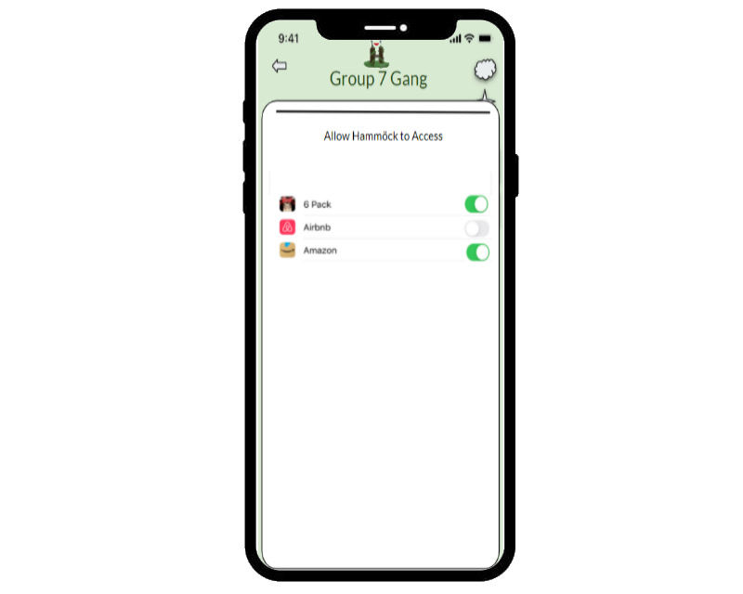
Group 7 Gang
Eric
Yo what’s up
Next User
Comment
Another User
Comment
M
Allow Hammöck to Access
Type to send message....

Slide 23
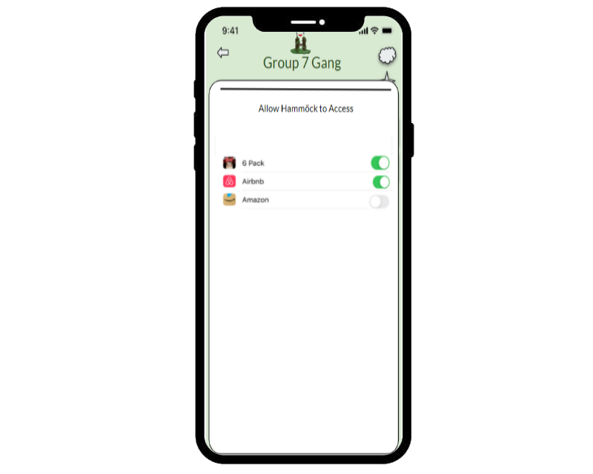
Group 7 Gang
Eric
Yo what’s up
Next User
Comment
Another User
Comment
M
Allow Hammöck to Access
Type to send message....

Slide 24

Group 7 Gang
Eric
Yo what’s up
Next User
Comment
Another User
Comment
M
Allow Hammöck to Access
Type to send message....

Slide 25

Group 7 Gang
Eric
Yo what’s up
Next User
Comment
Another User
Comment
M
Allow Hammöck to Access
Type to send message....

